Slide 1
AI Copilot Code Review using Large Language Models
CLUSTER -3 SECTION 7
Team Members
Name: BANDI SRIHITHA Rollno: 2420030099
Name: EMANI MAHATHI Rollno: 2420030093
Name: PRATHIPATI PRANATHI Rollno: 2420030043
Under the Esteemed Guidance of
Dr . KATANGURI SWANTHANA (CSE)

Slide 2
Contents
Problem Statement
Objectives
Literature Survey
Research Gap
Innovation & Creativity
Novelty
Feasibility
Project Plan
Proposed Architecture/Methodology
Datasets & Technology Stack
References

Slide 3
PROBLEM STATEMENT
Problem Statement
Software code review is essential for ensuring code quality, security, and maintainability. Traditional static analysis tools detect rule-based issues but lack contextual understanding, while Large Language Models (LLMs) generate intelligent suggestions but may produce inaccurate or unsupported recommendations. Existing approaches also lack repository awareness and issue prioritization. Therefore, an intelligent hybrid framework is required to generate accurate, explainable, and context-aware automated code reviews.
Motivation
Manual code reviews are time-consuming.
Static analyzers lack contextual understanding.
LLMs may generate hallucinated suggestions.
Existing systems ignore repository context.
Developers need explainable AI-assisted reviews.

Slide 4
OBJECTIVES
Objectives:
Develop an AI-powered automated code review system using CodeLlama to generate intelligent and context-aware review suggestions.
Support automated code review for Python, Java, and JavaScript using language-specific static analysis tools.
Integrate CodeBERT, FAISS, and Retrieval-Augmented Generation (RAG) to retrieve relevant code context and improve review accuracy.
Generate explainable review comments with issue descriptions, severity levels, confidence scores, and recommended code fixes.
Evaluate the proposed framework using CodeSearchNet, CodeXGLUE, and GitHub repositories to measure review quality and overall system performance.

Slide 5
LITERATURE SURVEY
Research Paper | Method | Advantages | Limitations
AI-powered Code Review with LLMs (2024) | LLM-based Review | Intelligent suggestions | Limited repository context
Security Code Review using LLMs (2024) | GPT + Security Analysis | Better vulnerability detection | High false positives
Evaluating Source Code Quality with LLMs (2024) | LLM Assessment | Improved maintainability | No static analysis
Hybrid LLM + Static Analysis (2025) | Static Analysis + RAG | Better review quality | Limited language support
Automated Code Review with Symbolic Reasoning (2025) | LLM + Reasoning | Better explanations | Higher computation
Common Research Challenges
Limited contextual code understanding.
Generic review recommendations.
Weak integration of review techniques.
Lack of issue prioritization, Limited multi-language support.

Slide 6
RESEARCH GAP
Research Gap | Proposed Solution
Limited understanding of repository context | Retrieve repository context using CodeBERT and FAISS
Generic and inconsistent review suggestions | Generate context-aware reviews using CodeLlama
Static analysis lacks semantic reasoning | Combine static analysis with LLM reasoning
No severity-based issue prioritization | Rank issues as Critical, High, Medium, and Low
Limited explainability of review comments | Provide reasons, fixes, and confidence scores

Slide 7
INNOVATION & CREATIVITY
Innovation
Repository-aware code review using FAISS-based RAG.
Hybrid integration of CodeLlama and static analysis.
Intelligent retrieval of similar code before review.
Context-aware code review with explainable suggestions.
Unified review report with prioritized issue severity.
Creativity
Simulates expert developer review workflow.
Combines rule-based and AI-driven analysis.
Supports Python, Java, and JavaScript.
Generates developer-friendly review explanations.
Modular architecture for future expansion.

Slide 8
NOVALITY
Existing System | Proposed System
Generic LLM review | Context-aware AI review
Static analysis only | Hybrid AI + static analysis
No repository context | CodeBERT + FAISS retrieval
Generic suggestions | Explainable recommendations
Equal issue priority | Severity-ranked review
Key Contribution
Hybrid AI-powered code review framework.
CodeBERT-based semantic code retrieval.
Repository-aware contextual review generation.
Explainable and severity-ranked suggestions.
Multi-language support for three languages.

Slide 9
FEASIBILITY ANALYSIS
Technical Feasibility
Open-source AI models and libraries available.
Supports Python, Java, and JavaScript.
Efficient retrieval using CodeBERT and FAISS.
Easy integration with static analysis tools.
Achievable within the proposed timeline.
Economic Feasibility
Uses open-source technologies.
No expensive model training required.
Low development and deployment cost.
Operational Feasibility
User-friendly Streamlit interface.
Easy integration into developer workflow.
Modular and scalable architecture.
Time Feasibility
Prototype completed within 4 phases
Based on existing AI and RAG technologies.

Slide 10
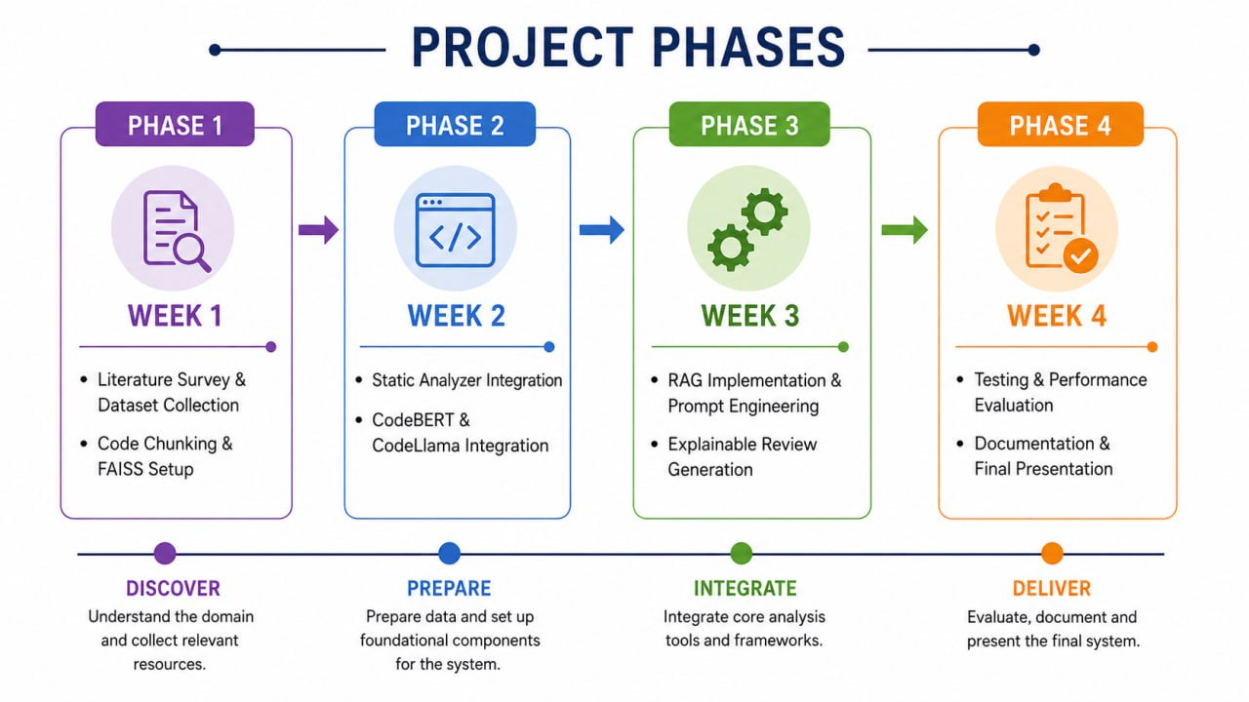
PROJECT PLAN
Expected Outcomes
Automate code review for Python, Java, and JavaScript.
Improve code quality through context-aware analysis.
Generate accurate and explainable review suggestions.
Prioritize issues based on severity levels.
Reduce manual code review effort and time.
Enhance developer productivity and code maintainability.
Provide a scalable framework for future language support.

Slide 11
DATA SET
Dataset | Purpose | Used In
CodeSearchNet | Similar code repository | CodeBERT embeddings & FAISS retrieval
CodeXGLUE | Code review benchmark | Performance evaluation
GitHub Public Repositories | Repository context | RAG retrieval & testing
Technology Stack:
Programming Language: Python
User Interface: Streamlit
Code Large Language Model: CodeLlama
Embedding Model: CodeBERT
Vector Database: FAISS
Static Analysis Tools: Pylint, PMD, ESLint
Retrieval Technique: Retrieval-Augmented Generation (RAG)
Datasets: CodeSearchNet, CodeXGLUE, GitHub Public Repositories
Evaluation Metrics: Precision, Recall, CodeBLEU

Slide 12
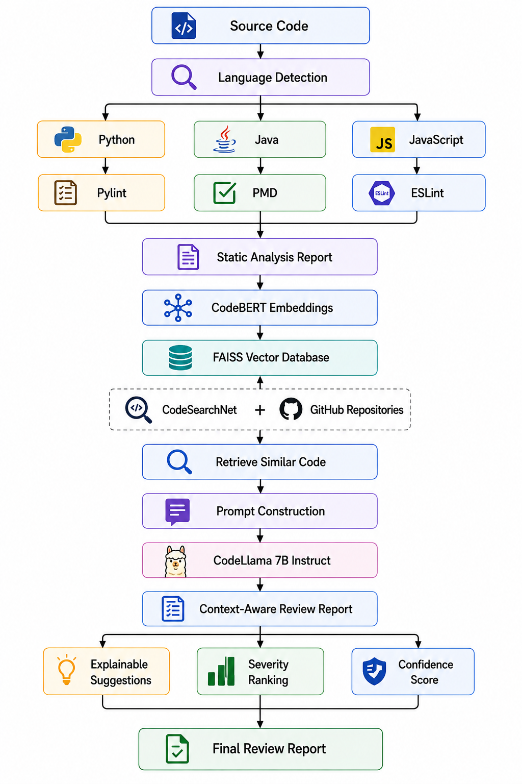
PROPOSED ARCHITECTURE/METHODOLOGY
Workflow
Upload source code.
Detect programming language.
Perform static code analysis.
Generate CodeBERT embeddings.
Retrieve similar code using FAISS.
Build contextual prompt.
Generate review using CodeLlama.
Produce explainable review report.

Slide 13
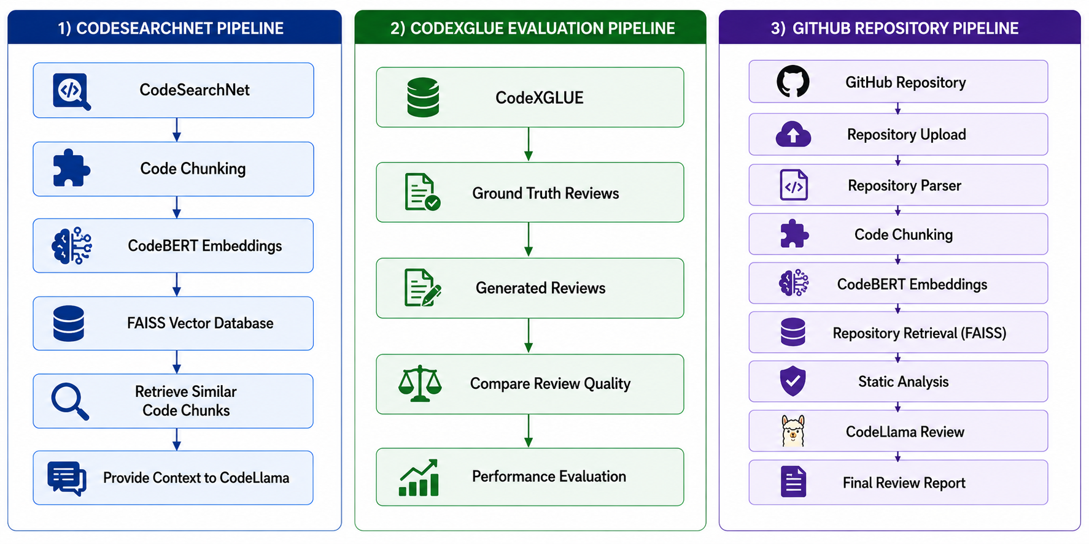
Flow Chart
How Each Dataset Fits Into Our Workflow?

Slide 14
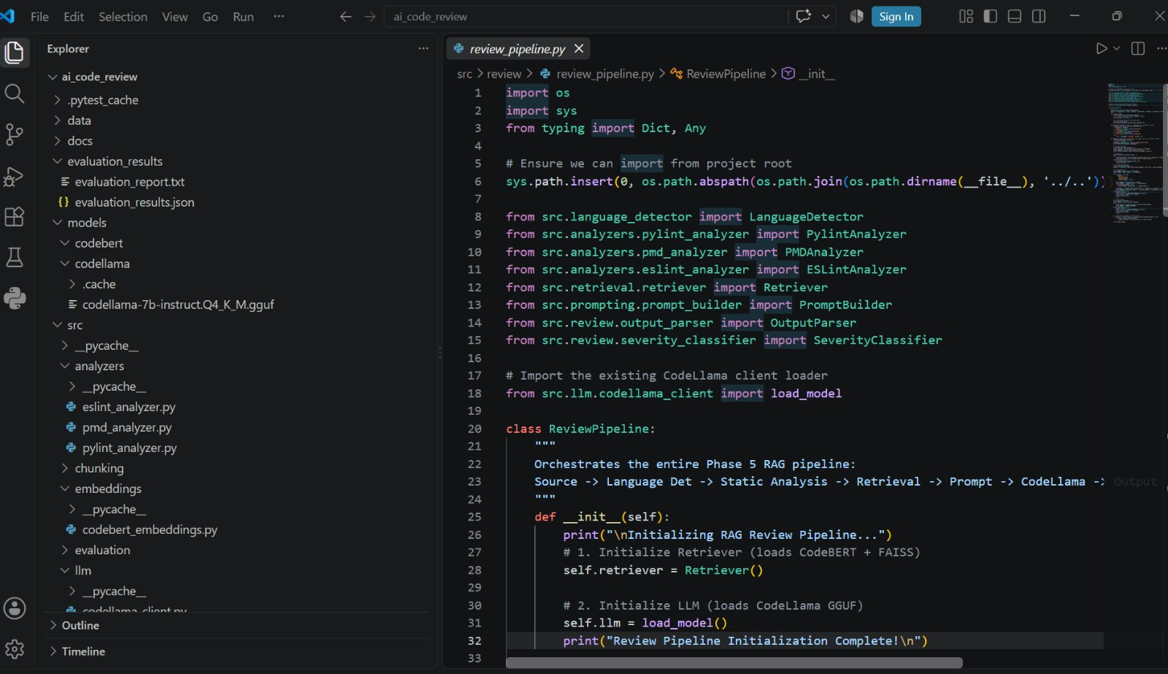
Result

Slide 15
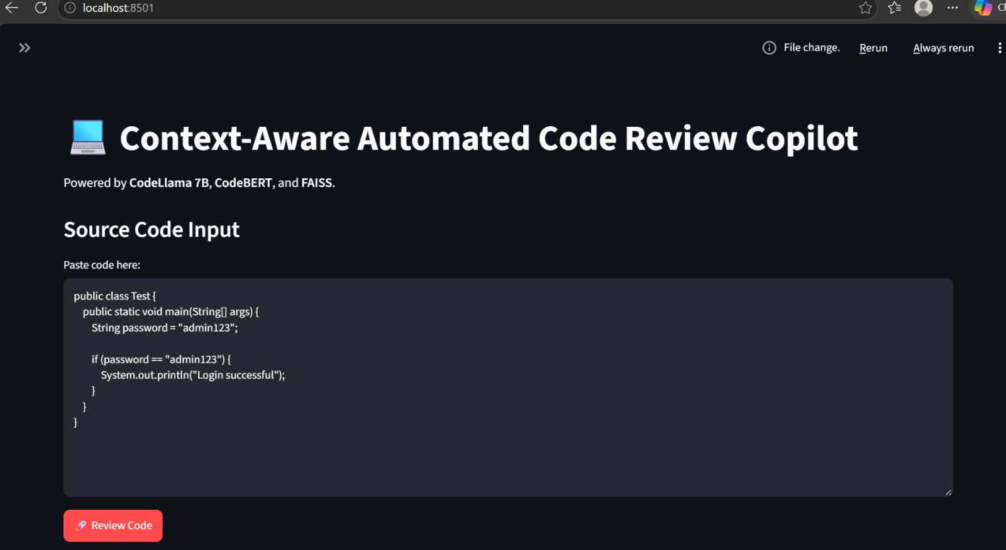
Front End

Slide 16
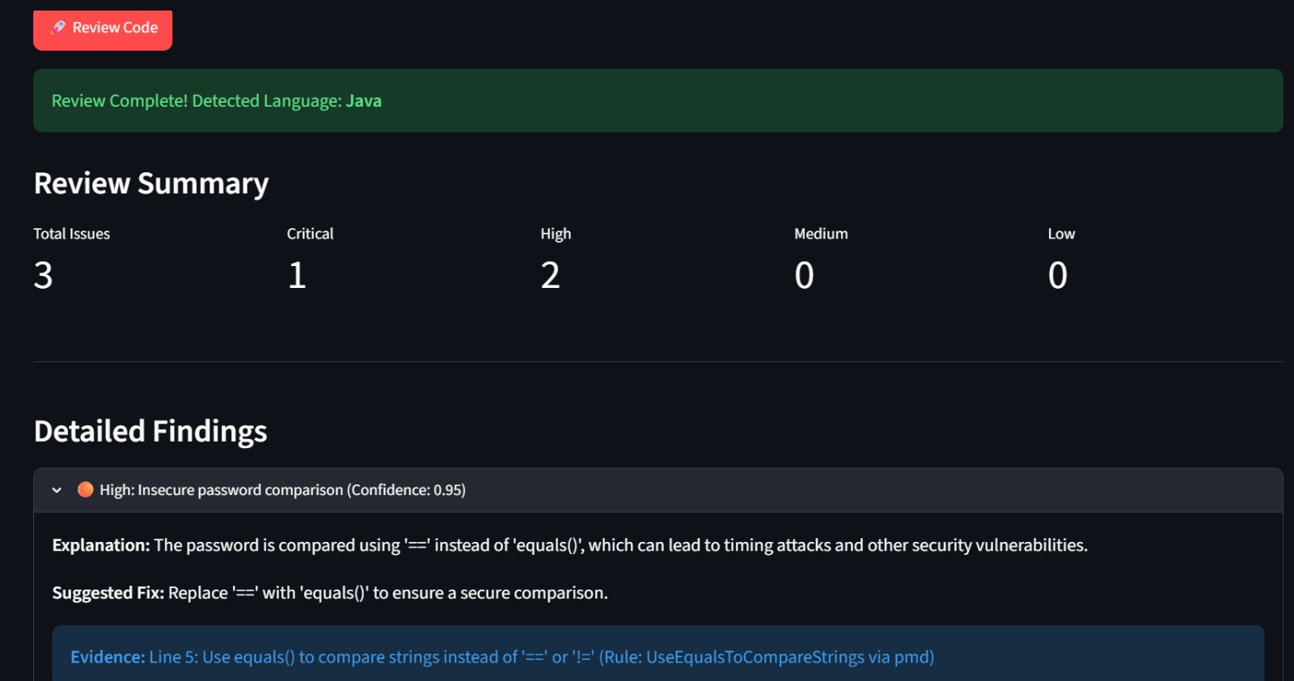

Slide 17
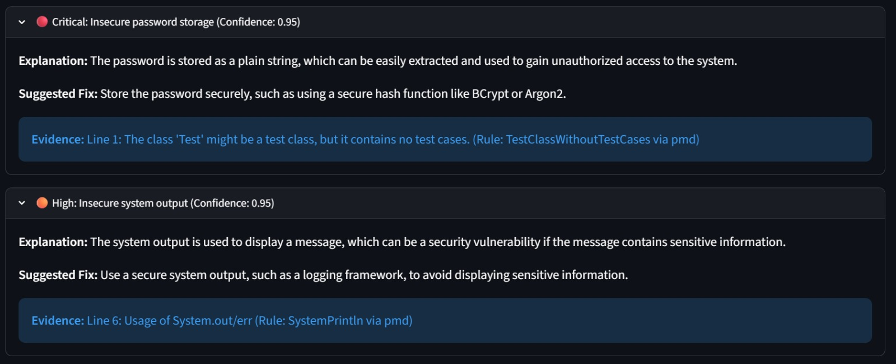

Slide 18
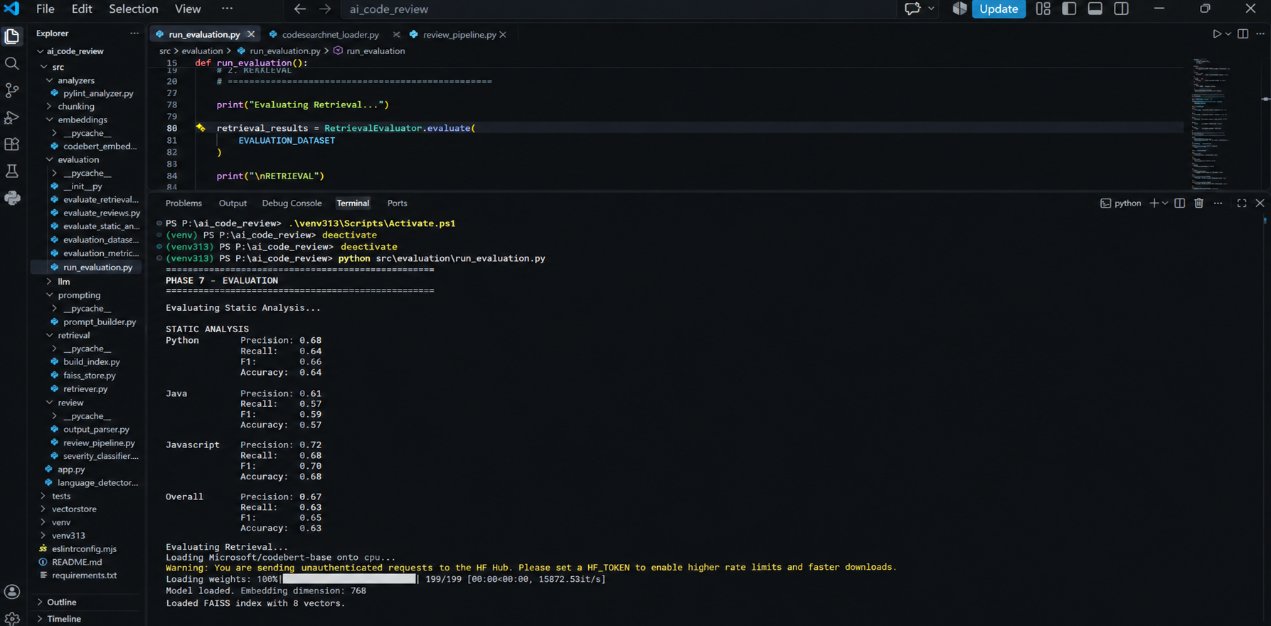

Slide 19
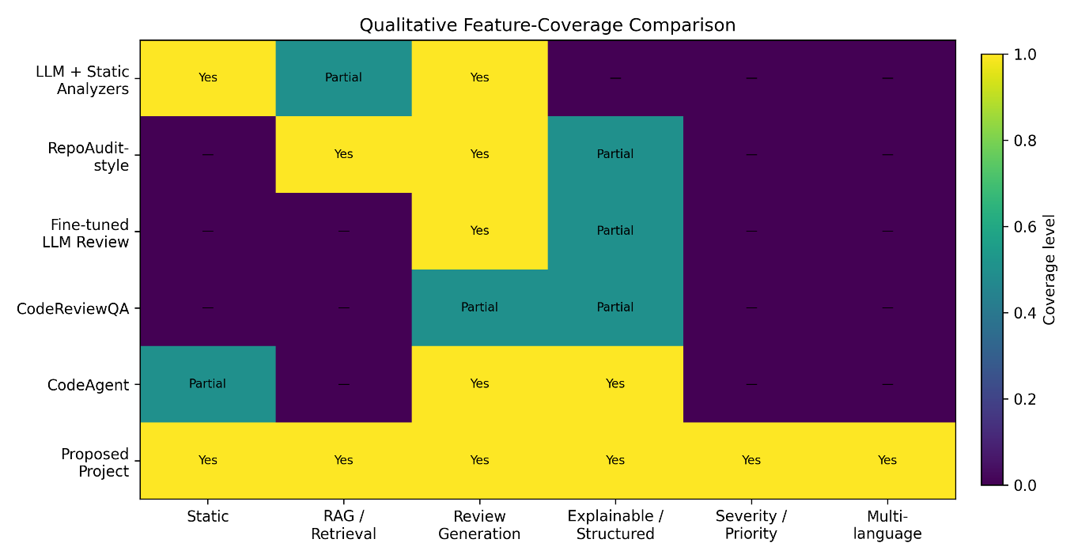
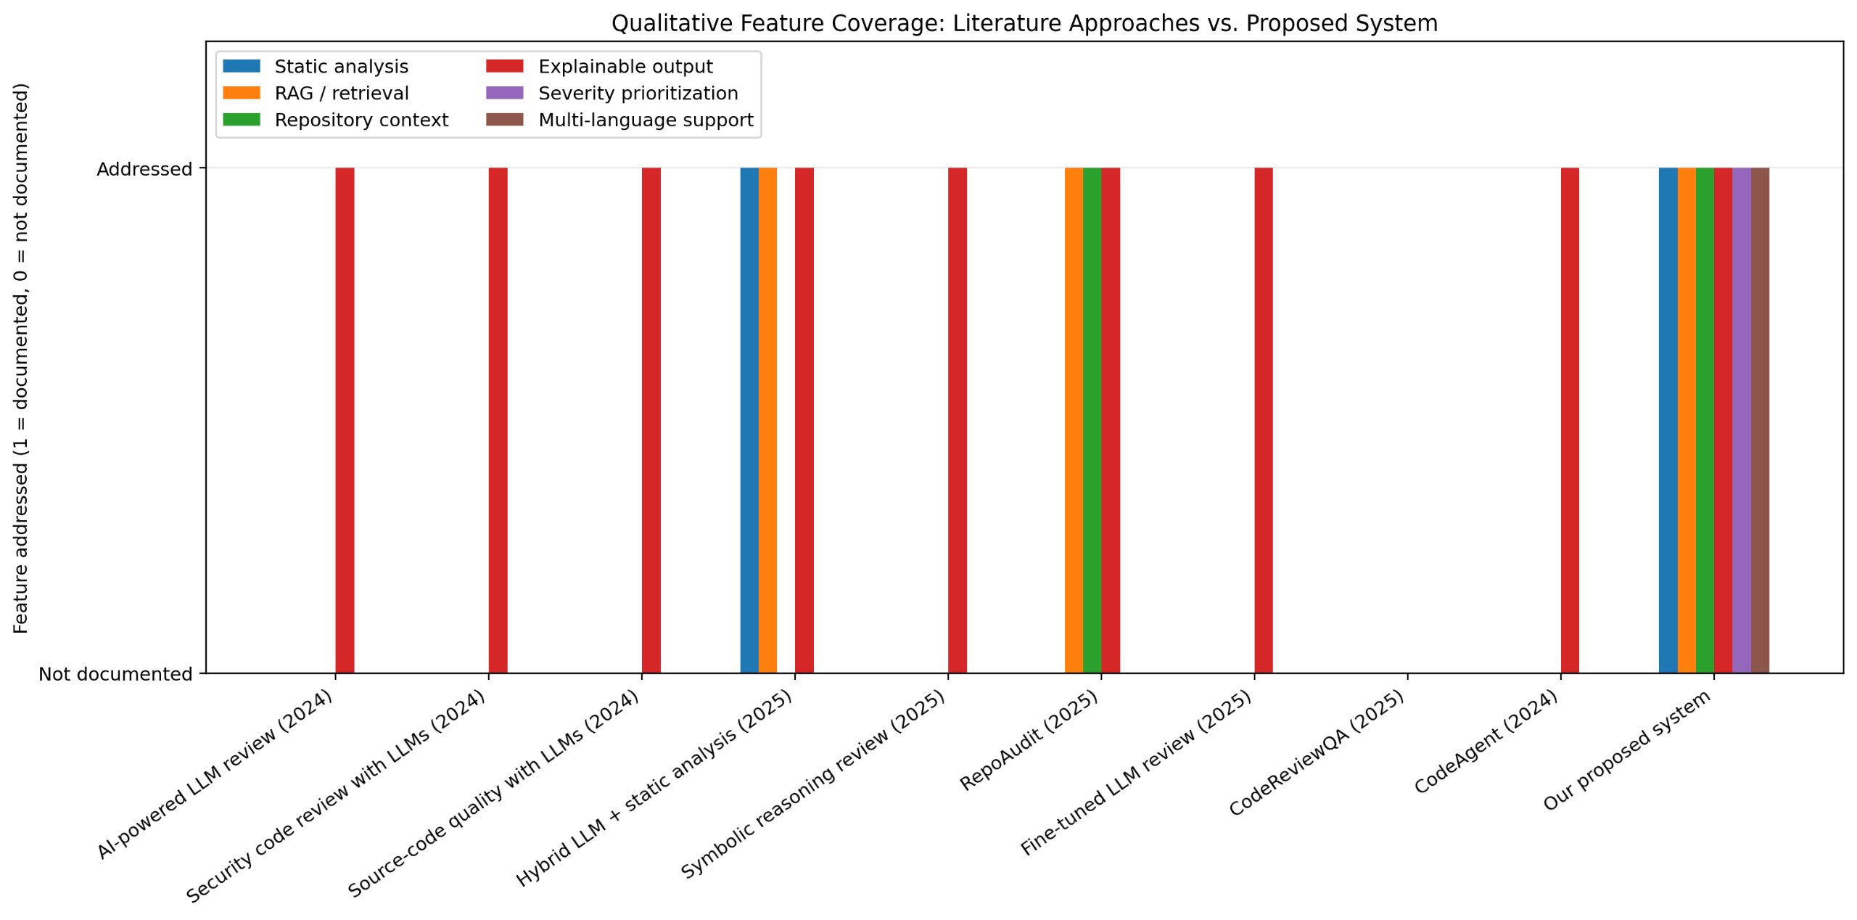
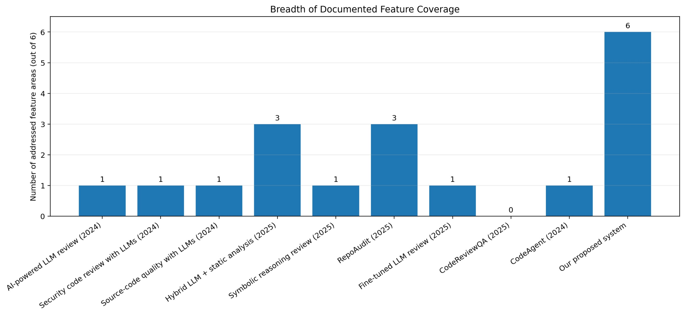
COMPARITIVE ANALYSIS

Slide 20
COMPARITIVE ANALYSIS

Slide 21
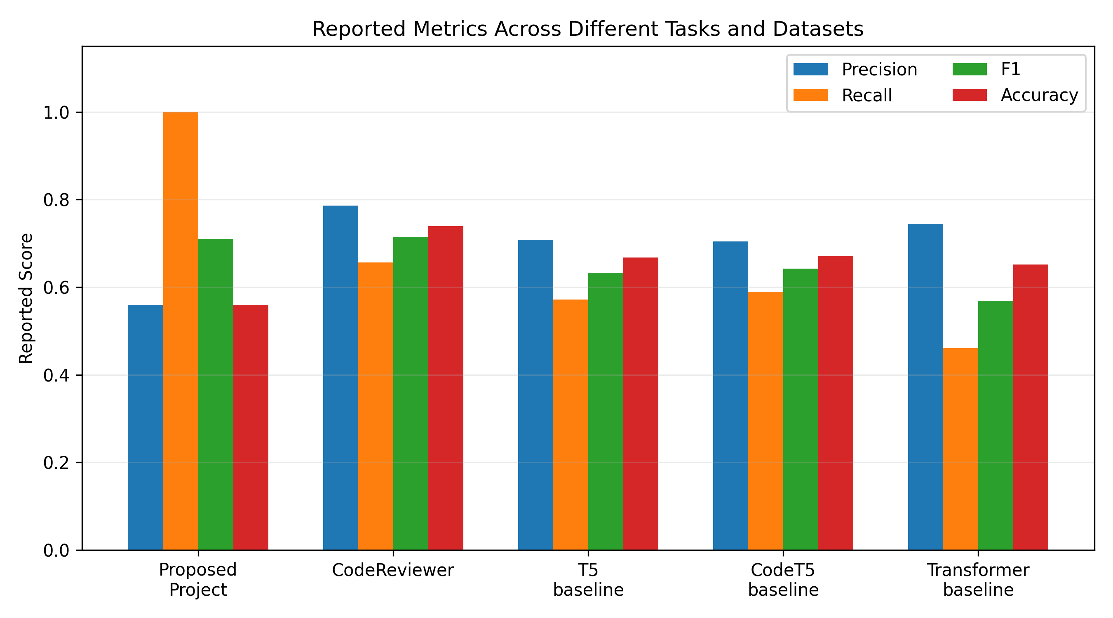
COMPARITIVE ANALYSIS

Slide 22
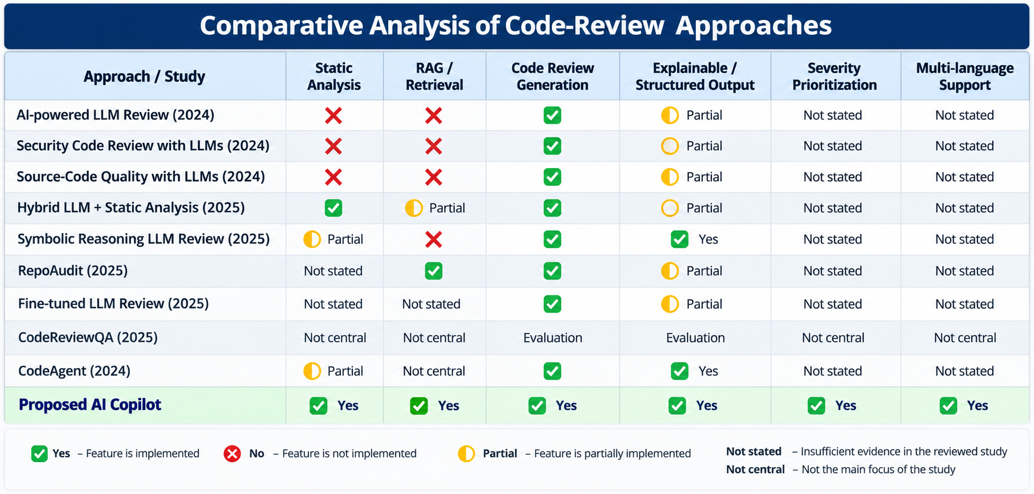
COMPARITIVE ANALYSIS

Slide 23
REFERENCES
B. Rozière et al., "Code Llama: Open Foundation Models for Code," Meta AI, 2023.
Z. Feng et al., "CodeBERT: A Pre-Trained Model for Programming and Natural Languages," Findings of EMNLP, 2020.
S. Lu et al., "CodeXGLUE: A Machine Learning Benchmark Dataset for Code Understanding and Generation," NeurIPS Datasets and Benchmarks, 2021.
H. Husain et al., "CodeSearchNet Challenge: Evaluating the State of Semantic Code Search," Empirical Software Engineering, 2021.
J. Johnson, M. Douze, and H. Jégou, "Billion-scale Similarity Search with GPUs (FAISS)," IEEE Transactions on Big Data, 2019.
P. Lewis et al., "Retrieval-Augmented Generation for Knowledge-Intensive NLP Tasks," Advances in Neural Information Processing Systems (NeurIPS), 2020.
"AI-powered Code Review with Large Language Models: Early Results," 2024.
"An Insight into Security Code Review with Large Language Models," 2024.
"Evaluating Source Code Quality with Large Language Models," 2024.
"Combining Large Language Models with Static Analysis for Automated Code Review," 2025.

Slide 24
Thankyou

